Slide 1
Science Gateway Security Considerations
Applications of OAuth2 and OpenID Connect to Science Gateways
https://tools.ietf.org/html/rfc6749

Slide 2
Background
We have three major divisions in a science gateway architecture.
Science gateway tenants are what the end user interacts with.
Domain specific: SEAGrid.org, SimVascular, etc
Maintain their own user bases
Science gateway middleware provides general purpose services that are used by gateway tenants.
One middleware instance can support multiple science gateway tenants and multiple resources
Science gateway resources are typically externally managed clusters or IaaS providers that run scientific applications and store data
A user “rents” space on a resource

Slide 3
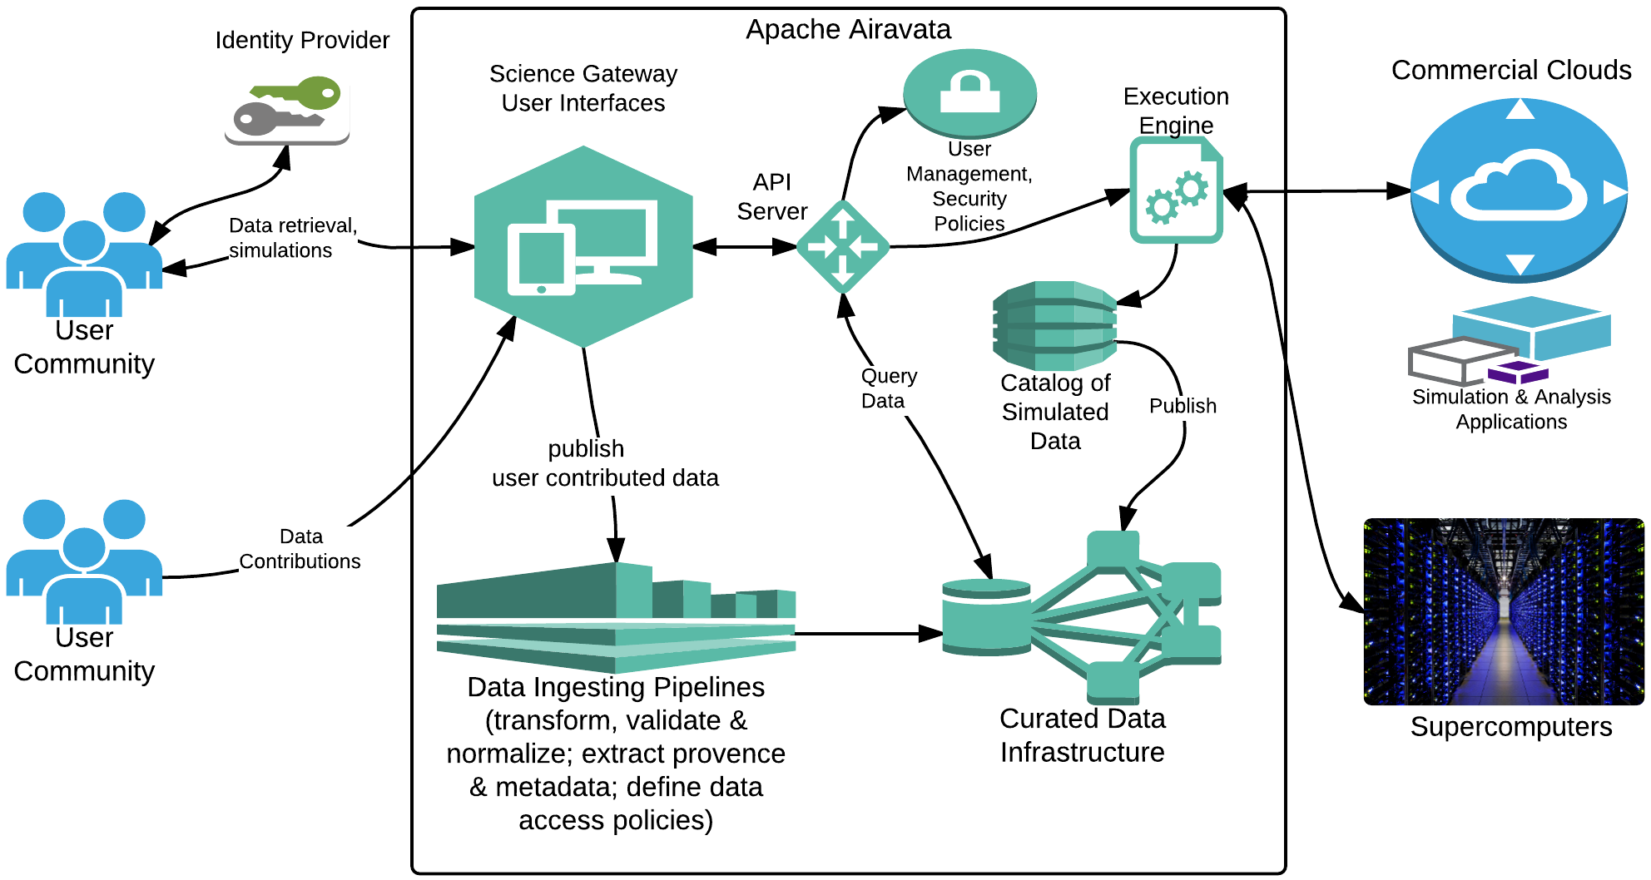
Apache Airavata: Science Gateway Middleware

Slide 4
Gateways Need to Provide Three Types of Security
Authenticate users and manage their profiles.
Manage the “secrets” needed to access remote resources
Private keys, passwords, access tokens, etc
Security between the middleware and remote resources
Manage access to digital objects (metadata) created and managed by the gateway
User experiments and projects
Metadata representations of computing resources, scientific applications, etc.
Security within the middleware itself
We have a project, Custos, that will make these parts of Apache Airavata into a standalone capability. Potential Fall 2019 focus area.

Slide 5
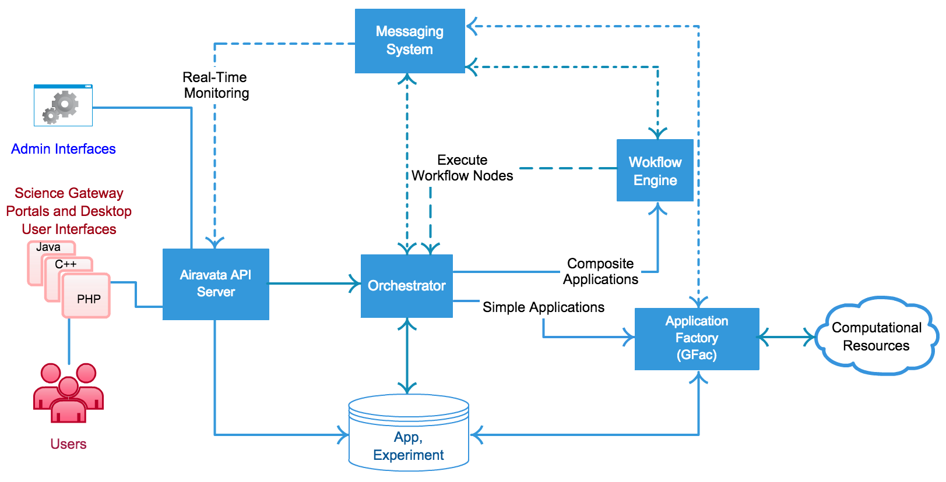
Simplifying Assumption: the Middleware Perimeter
We don’t consider the problem of securing the microservices themselves.
Assume all the microservices run under a single administrative domain.
Use “operational security” rather than “architectural security”
Firewalls, closed networks and similar approaches to limit access to services to trusted entities.
Logging and event detection
Some interesting further Microservice security considerations:
Rogue services, Byzantine Fault Tolerance: RAFT
Scaling your operational perimeter
Integrating trusted third party services like Box.

Slide 6
Apache Airavata: High Level Architecture

Slide 7
Zoom in on the UI and API Server
UI: this is the gateway tenant
The API Server can communicate with multiple tenants.
Tenants can be Web servers, mobile applications, native browser JavaScript apps, or desktop applications.
Tenants and the API server communicate over network connections (TCP or HTTPS)
Gateway Tenant
Gateway Tenant
Gateway Tenant
API Server
Apache Airavata Middleware

Slide 8
Security Challenges for Gateway Architectures
We need to establish trust between a gateway tenant and the API server.
The gateway tenant may manage its own user base, but these must be communicated to the API server.
A gateway tenant may be a single web server for an entire community
The SEAGrid Web server, for example
A gateway tenant also may be a desktop application, scripting tool, or in-browser application that get distributed to every user.
Need unique credentials for each client
Credentials are more vulnerable
OAuth2 can address many of these issues.

Slide 9
Network Security and OAuth2
A basic introduction

Slide 10
Entities on a Network
Entity 1
Entity 2
Network Communications
(TCP/IP)

Slide 11
Security Concept | Description
Identity | Entities have unique identities.
Authentication (AuthN) | Entities can establish and prove their identities. Commonly implemented with public-private key pairs
Authorization (AuthZ) | How an entity responds to a request from another entity. Usually coupled with authentication.
Message Signing | Entities can verify that messages came from a particular authenticated entity. Implemented with cryptographic keys
Message Integrity | Detecting if the network message between entities has been altered. Implemented with message digests (hashes).
Message Privacy | Communications between entities can only be read by those entities. Implemented with encryption, shared secret keys
Message Singularity | Each message between entities is unique. Avoids accidental or malicious replays. Uses nonces, timestamps, etc.
Some Basic Network Security Concepts

Slide 12
The Authorization Problem
Trust Boundary
Resource Owner
Client
Resource Service
The Resource Owner wants to authorize the Client to act on Resource Service on the Resource Owner’s behalf. How do you do delegate this authority?

Slide 13
Authorization and 3rd Party Services
This scenario has become very common.
Platforms and devices such as Facebook, Google, and Apple IPhones hold your personal data.
Third party applications need to access some of this data.
You decide which applications to authorize
“Facebook, it is ok for this application to access the names of my Facebook friends and other personal information.”
“IPhone, it is OK for this app to know my location”
I am the Resource Owner. My list of friends, personal information, and location are accessible through a Resource Service. Facebook and IPhone apps are Clients.

Slide 14
Problems Delegating Authority
Straightforward Approach: Client requests an access-restricted resource by authenticating using the resource owner's credentials, like passwords
The Resource Owner shares its credentials with the third party Client.
The Client impersonates the Resource Owner.
This is a really bad solution
What are some problems with this approach?
Resource Owner
Client
Resource Service

Slide 15
Some Problems with Credential Sharing
Third-party applications gain overly broad access to the Resource Owner's protected resources.
No ability to restrict duration or access to a limited subset of resources.
Resource Owners cannot revoke access to a specific client without revoking access to all clients
Requires the Resource Owner to change passwords.
Compromise of the client results in compromise of the end-user's long term credentials and all of the data protected by that password.
Compromise of one client compromises all of the clients and all of the Resource Services.
The Resource Owner would need to change passwords on all clients

Slide 16
Introducing OAuth2
OAuth2 solves this problem by introducing a mutually trusted* Authorization Service
AuthZ Service
Resource Owner
*There are rigorous ways, like key exchanges, for establishing mutual trust.
Client
Resource Service

Slide 17
OAuth2 Main Concepts
OAuth2 introduces an authorization layer
Separates the role of the client from that of the resource owner.
In OAuth2, the client is issued a different set of credentials than those of the resource owner.
OAuth2 access tokens rather than passwords
An OAuth2 access token has a specific scope, lifetime, and other access attributes.
These limit what the Client can do and how long the Client’s requests are valid
Access tokens are issued to third-party clients by an Authorization Server with the approval of the Resource Owner.
The Client uses the access token to access the protected resources hosted by the Resource Server.

Slide 18
Credentials vs. Tokens
Resource Owner Credentials
Access Tokens
Can be used by the client to do anything the user can do
Don’t expire
User has to manually change them
All Clients use the same credentials for a particular Resource Owner
Can be associated with specific, limited operations
Read but not write
Have a specific lifetime
Generated by the Authorization Server, not a human
Each Client has a different token

Slide 19
Types of OAuth2 Clients
Client Type | Description
Web Application | Confidential client that runs on a Web server. Client credentials and access tokens are stored on a Web server.
Native Applications | Public client that runs on a device used by the Resource Owner. Client credentials and access tokens are stored on the device. Examples: mobile devices and desktop clients
User Agent Applications | Public client code is downloaded from a server and runs on the user’s device (Web browser). Client credentials and access tokens are stored on the user’s device.
These clients have different security implications

Slide 20
Client Registration: Trusting the Client
Clients register with the Authorization Server
This is a one time operation.
The Client can be either confidential or public
Confidential: a web server-based Client, for example
Public: Browser, desktop, or mobile clients
The Authorization Server issues a client identifier to the Client
Unique string representing the information provided by the client.
Confidential Clients authenticate to the Authorization Server
Passwords, key pairs, secrets, etc.
Clients should come from trusted “App Stores”

Slide 21
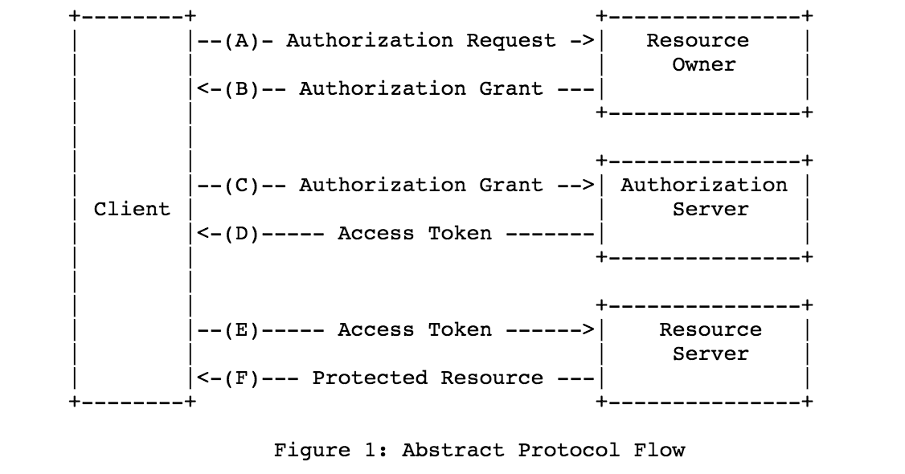
OAuth2’s Abstract Protocol Flow

Slide 22
OAuth2 In Brief...
The Resource Owner issues a grant to the client.
The grant usually comes from the Authorization Service
The Client uses the grant to get an access token from Authorization Service.
The Client uses the access token to make requests from the Resource Service.
OAuth2 has several grant types that are appropriate for different scenarios.

Slide 23
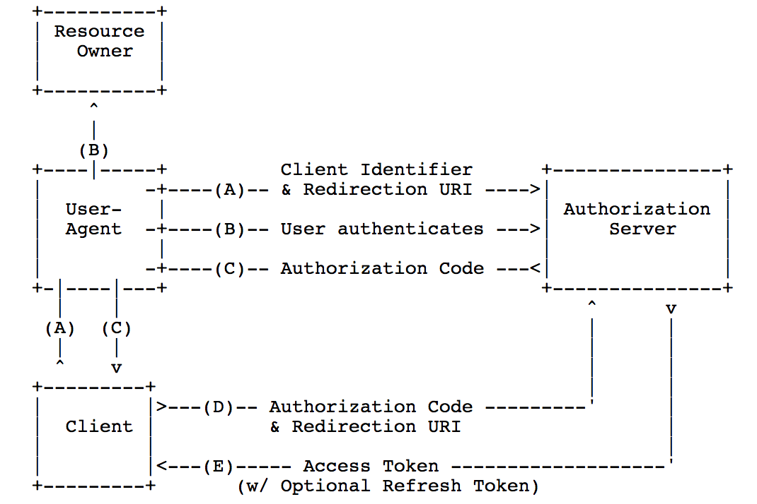
Authorization Code Grant Type for Private Clients
The Client is a server side application
The Resource Owner attempts to use the Client to access a Resource Server (not shown in figure)
When complete, the Client can use the Access Token to access the Resource Server.
Resource Owner is a person, and User-Agent is a Web browser.
This is the most common grant type.

Slide 24
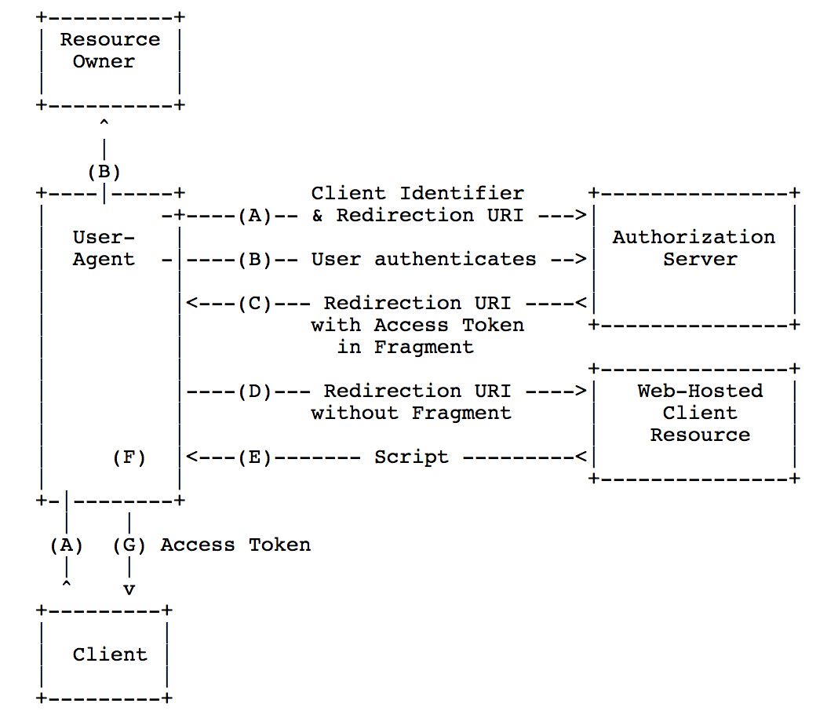
Implicit Grant Type for Public Clients
Authorization flow suitable for Clients that run as JavaScript applications in the user’s browser.
Client gets the access token directly in a redirect URL, skipping the authorization code step.
Convenient but less secure.

Slide 25
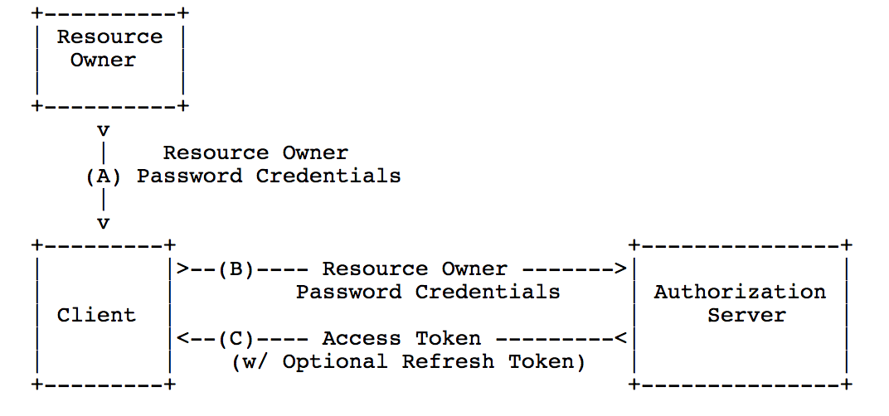
Resource Owner Password Credentials
Resource Owner gives the Client its full credentials.
Client uses these to obtain an access token and possibly refresh tokens.
Owner must trust the Client, and Client can use the credentials only once per access token.
Best way to authorize desktop applications?

Slide 26
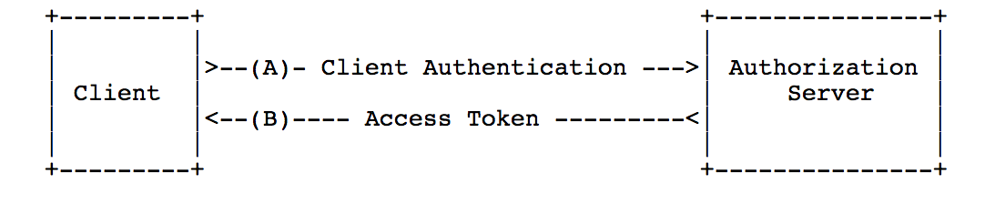
Client Credentials Grant Type
Client and Resource Server are owned by the same entity, or Client and Resource Owner are the same.
Ex: Facebook’s internal services only access your personal data if you authorize them.
Machine-to-machine, no human in the loop
You could use this between microservices within your perimeter

Slide 27
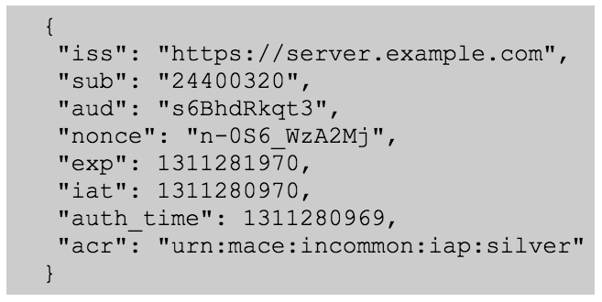
What Are Access Tokens?
These may be identifiers (“kdjk-111-dkjfkljd-0kdkj-kwjlej”) meaningful only to the Resource Server
Or they may be structured and meaningful
JSON Web Tokens
OpenID Connect Tokens (shown)
SAML
The Client may not understand or even decrypt the token

Slide 28
Refresh Tokens
Access tokens should expire in order to limit their potential misuse.
Refresh tokens are used to obtain new access tokens after the access token has expired.
Issued to the Client by the Authorization Server when the Access Token is issued.
Refresh tokens are optional

Slide 29
OpenID Connect: A Summary
An OAuth2-Based Authentication Protocol
http://openid.net/connect/

Slide 30
What Is OpenID Connect?
Authentication as a Service
Don’t run your own authentication service
Use a trusted service instead
Authentication mechanisms and details handled by the service.

Slide 31

Why Use OpenID Connect?
The trusted Identity Provider (IdP) absorbs lots of headaches
Best practices and implementations for securing user accounts and information.
Avoids the need to provide separate identity management for every application
Handles federated identities.
Handles advanced authentication mechanisms such as two-factor authentication

Slide 32
Examples
CAS: not OpenID Connect based, but similar
CILogon: a service from University of Illinois that provides federated identity
Keycloak: Open source software for running your own IdP. We use this for Apache Airavata.
Google, Microsoft, Amazon, Auth0, and others run OpenID Connect services for you.

Slide 33
OAuth2 and OpenID Connect
OAuth2 is used to authorize clients to access resources using access tokens.
Establishing client identity is a one-time operation
Access tokens are used to access services.
OpenID Connect uses the same ideas to authenticate users before they can access services.
Clients can also obtain basic profile information about the user in an interoperable and REST-like manner.
Suitable for APIs, not just browser clients

Slide 34
Direct Authentication
User + Browser
Web Application in Server
HTTPS + Basic Auth
User DB

Slide 35
Authentication as a Service
IdP
(2) User Authenticates
User + Browser
(3) IdP confirms authentication
Web Application in Server
(1) Web App Redirects User to the IdP

Slide 36
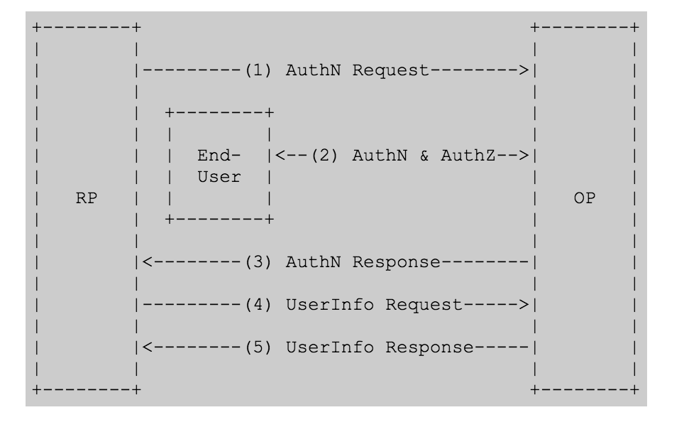
Basic OIDC Flow
OpenID Connect Provider (i.e., Google)
Relying Party. This is the OAuth2 Client.

Slide 37
Basic OIDC Steps
The Relying Party (RP) sends a request to the OpenID Provider (OP).
This is the science gateway
The OP authenticates the End-User and obtains authorization.
The OP responds with an ID Token and usually an Access Token.
Verifies to the client that the user authenticated correctly.
The ID Token is specific to OIDC and is its primary extension of OAuth2
The RP can send a request with the Access Token to the UserInfo Endpoint.
The UserInfo Endpoint returns Claims about the End-User.
We can make use of the Access Tokens for other authorization decisions.

Slide 38
OAuth2, OpenID Connect and Science Gateway API Servers
Variations on the OAuth2 Scenarios
Apache Airavata API Security: Exploring Identity and Access Management Solutions for Multi-Tenanted eScience Framework, Supun Nakandala, Indiana University; Hasini Gunasinghe, Purdue University; Suresh Marru*, Indiana University; Marlon Pierce, Indiana University
http://escience-2016.idies.jhu.edu/program/hot-topics-invited-talks/

Slide 39
General Gateway Issues
Science Gateways use middleware for common, generic functions.
Execute jobs, manage data and metadata
Middleware (Airavata) needs a scalable way to establish trust with numerous science gateway tenants.
Gateway tenants can be Web clients but also desktop clients.
These have very different security concerns.
Science gateways need a way to authenticate users.
Gateway Tenant
Gateway Tenant
Gateway Tenant
API Server
Apache Airavata Middleware

Slide 40
General Requirements
A gateway is an OAuth2 Client
The gateway’s users are Resource Owners
Airavata is the Resource Service
We use Keycloak (formerly WSO2 IS) as our Authorization Server
We need to establish a user’s identity
Users may have different levels of access to API methods
Some may have admin roles, for instance
Auth Service
Resource Owner
Client
Resource Service

Slide 41
SEAGrid Scenarios
SEAGrid needs to authenticate users.
Not all users can access every Apache Airavata API method.
SEAGrid has both Web and desktop (JavaFX) clients.
These are clients to Apache Airavata services.
Web client (PHP) runs on a server under the control of the SEAGrid administrator.
But desktop clients run under the user’s control.
User could lose credentials.
Apache Airavata needs to issue access tokens to invoke API calls to both the SEAGrid web site and to SEAGrid desktop clients.

Slide 42
Our Conclusions About OAuth2 and Gateways
OAuth2 Grant Type | Science Gateway
Authorization Code | Web-based, server side gateway implemented with PHP, JSP/servlets, Django, etc. The Airavata client SDK is on the server under the gateway operator’s control
Implicit | Client is a browser using JavaScript client SDKs to make direct connections to the Airavata server; no Web server in the middle
Resource Owner Password | Client is a trusted non-browser application under the user’s control, such as a mobile device or a desktop application.
Client Credential | Machine-to-machine authentication for confidential clients

Slide 43
How Do We Handle Authentication, User Management, and API Access?
Let’s look at several cases. These depend on how closely the tenant integrates with Airavata’s auth services.

Slide 44
First, Some Acknowledgements
Supun Nakandala and Hasini Gunasinghe prototyped much of what we do in production today while Google Summer of Code students
We put it into production
We hired Supun
Anuj Bhandar did a lot of the work evaluating and providing early integration work for Keycloak, which replaced WSO2 IS, during the Spring 2017 semester.

Slide 45
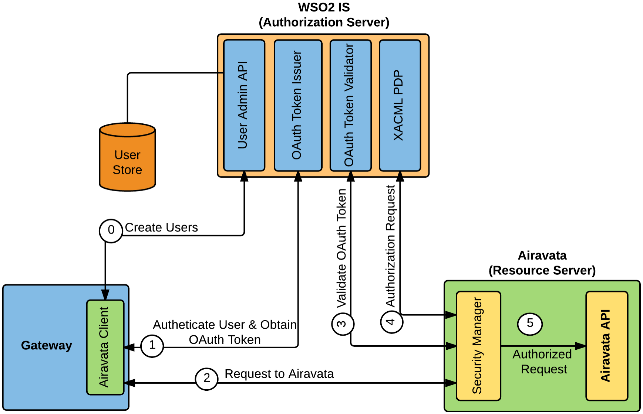
Case 1: Gateway uses Airavata middleware to manage users.
The gateway can use OpenID Connect to authenticate users.
The gateway receives an authorization code grant that it can use to make Airavata API calls.

Slide 46
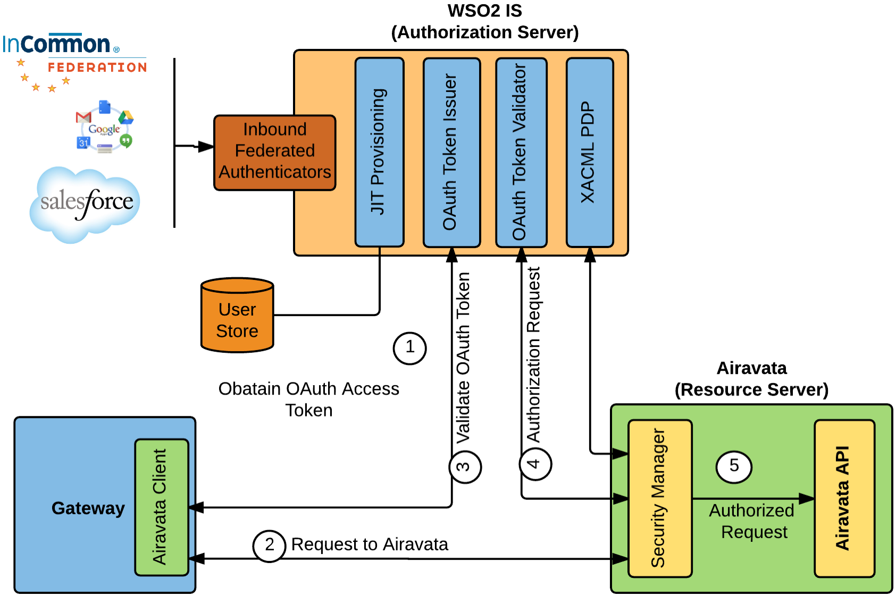
Case 2: Gateway uses a third party identity service to manage users.
This must be Web based, so Authorization Code grant types are the only supported type.

Slide 47
Some Open Issues
What is the best way to distribute OAuth2 public clients that will directly access the API
Desktop applications
Jupyter notebooks
Other scripts, developer keys, etc
How can we integrate third party services like Box or AWS into Airavata.
Users may bring their own accounts
Or a gateway tenant may provide a group account
What are the best approaches for internal (microservice-to-microserivce) security in Airavata?
Byzantine Fault Tolerance
DevSecOps
Black hat hacking

Slide 48
Recall an Earlier Slide
We have three major divisions in a science gateway architecture.
Science gateway tenants are what the end user interacts with.
Domain specific: SEAGrid.org, SimVascular, etc
Maintain their own user bases
Science gateway middleware provides general purpose services that are used by gateway tenants.
One middleware instance can support multiple science gateway tenants and multiple resources
Science gateway resources are typically externally managed clusters or IaaS providers that run scientific applications and store data
A user “rents” space on a resource

Slide 49
Can You Treat the Supercomputers as OAuth2 Resource Services?

Slide 50

Yes, You Can! Sort of.
You can create virtual clusters on Jetstream, Amazon, etc that can be used to run scientific codes.
You can integrate third party storage services like Box this way.
But we will have to wait on the OAuth2-enabled supercomputer

Slide 51

Enabling Users to Bring Their Own Resources
Store Access token
GW
Custos
Resource (AWS, Box)
Success
Redirect
Access token,
redirect to
Custos
Access Token
Resource
Added

Slide 52
Custos Components
Single server that embeds KeyCloak and other functionalities
API
KeyCloak
User Management
CredentialStore/Vault
Primary user store
Storing auth codes, ssh keys, generate keys
Sharing Service
Manages resource authentication for a user + throttling, limiting user access to resource.
Profile Service
Resource Authentication/
Authorization
Registering client ids, client secrets + other admin/monitoring things
Admin/
Monitoring
Secure audits, manages audit queries
Auditing

Slide 54
OIDC Mappings to OAuth2
The OIDC server is the Authorization Server.
The Science Gateway is the Client
Grant Types used by OIDC
Authorization Code: most common code, useful for server-side Web applications
Implicit: Use this with browser-side JavaScript applications that need to interact with the OIDC Server directly.

Slide 55
The OIDC ID Token (1/2)
ID Token data structure is the primary extension that OpenID Connect makes to OAuth 2.0 to enable End-Users to be authenticated.
The ID Token is a security token that contains Claims about the authentication of an End-User by an Authorization Server when using a Client, and potentially other requested Claims.

Slide 56
The OIDC ID Token (2/2)
The ID Token is represented as a JSON Web Token (JWT)
JWT: compact claims representation format intended for space constrained environments such as HTTP Authorization headers and URI query parameters.
https://tools.ietf.org/html/draft-ietf-oauth-json-web-token-32

Slide 57
Sample OIDC ID Token

Slide 58
Parameter | Value
iss | Issuer Identifier for the Issuer of the response. The iss value is a case sensitive URL using the https scheme that contains scheme, host, and optionally, port number and path components and no query or fragment components.
sub | Subject Identifier. A locally unique and never reassigned identifier within the Issuer for the End-User, which is intended to be consumed by the Client
aud | Audience(s) that this ID Token is intended for. It must contain the OAuth 2.0 client_id of the Relying Party as an audience value. It may contain other values.
nonce | String value used to associate a Client session with an ID Token, and to mitigate replay attacks.
exp | Expiration time
iat | Time at which the JWT was issued.
auth_time | Time when the End-User authentication occurred.
acr | Authentication Context Class Reference. You can used an RFC 6711 Registered Name here. This is an established Level of Assurance identifier.

Slide 59
Additional Claims
OIDC ID Tokens can also contain additional claims about the user.
Examples: Full name, preferred name, profile page URL, picture, website, birthday, etc.
These are stored by the UserInfo Endpoint. Not all may stored, and sharing decisions are another story.
OIDC clients (science gateways) can also make subsequent requests for this information from a UserInfo Endpoint.

Slide 60
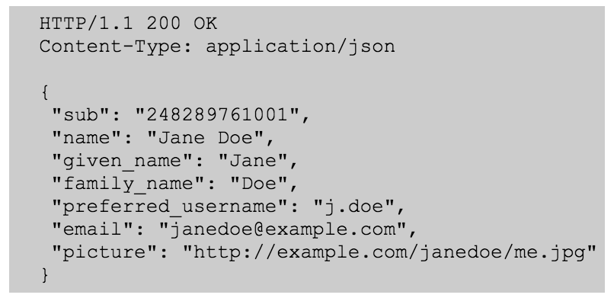
UserInfo Endpoint
The UserInfo Endpoint is an OAuth 2.0 Protected Resource that returns Claims about the authenticated End-User.
The Client makes a request to the UserInfo Endpoint using an Access Token obtained through OpenID Connect Authentication.

Slide 61
OpenID Connect Client Request Parameters
Parameter | Value
client_id | A client identifier established between the OIDC server and the client app.
response_type | The value “code” for Authorization Code grant types. Use “id_token” for Implicit grant types.
redirect_uri | The HTTP endpoint on your server that will receive the response from the OIDC server.
scope | In a basic request should be openid email.
state | Should include the value of the anti-forgery unique session token, as well as any other information needed to recover the context when the user returns to your application, e.g., the starting URL.

Slide 62
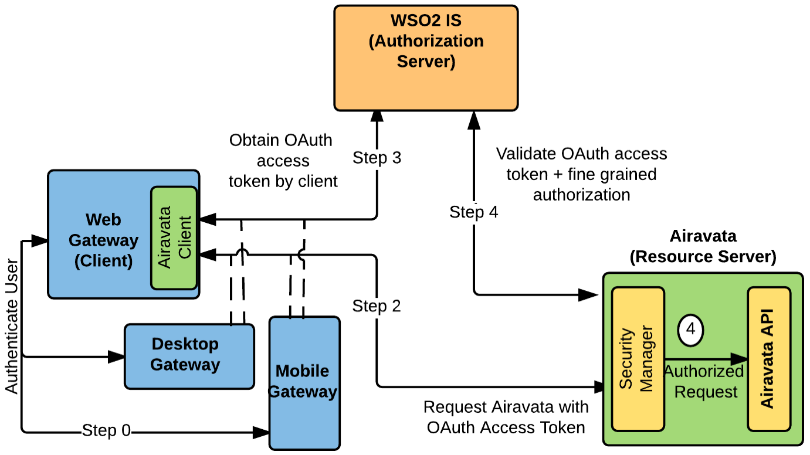
The General Solution

Slide 63
Out of Scope
Compared to the obsolete OAuth version 1, OAuth2 is a high-level framework and does not prescribe a lot of low level implementation details.
OAuth2 recommends TLS security between parties.
Other steps left for implementations and other standards
You could use lots of standard security practices on top of HTTPS that supplement the point to point nature of HTTPS/TLS.
Public-private key pairs
Message digesting
Messaging signing
Encryption

Slide 64
Grant Type | Description
Authorization Code | Client directs the Resource Owner to an Authorization Server. Resource Owner authenticates to the Authorization Server Auth Server issues an auth code to the Resource Owner and then directs the Resource Owner back to the Client. The Client uses the auth code to get an access token directly from the Authorization Server
Implicit | Authorization flow suitable for JavaScript clients in a browser. Client gets the access token directly in a redirect URL, skipping the authorization code step. Convenient but less secure.
Resource Owner Password Credentials | Resource Owner gives the Client its full credentials. Client uses these to obtain an access token and possibly refresh tokens. Owner must trust the Client, and Client can use the credentials only once per access token. Best way to authorize desktop applications?
Client Credentials | Client and Resource Server are owned by the same entity, or Client and Resource Owner are the same. Ex: Facebook services only access your personal data if you authorize them. Machine-to-machine, no human.

Slide 65
Assumptions in OAuth2
Auth Service
Resource Owner
What are some ways to attack OAuth2? How can OAuth2 defend against these attacks?
Client
Resource Service

Slide 66
Operational Considerations
Logging is essential: OAuth2 entities should log both valid uses and invalid attempts
Your log system should flag invalid attempts
Forensic audits after break-ins need logs
Denial of Service Attacks can be effective against security systems and need implementation mitigations
If I bombard the Authorization Server or Resource Server with invalid messages, I can prevent valid uses and may even be able to crash a server

Slide 67
Some OAuth2 Network Security Considerations (1/6)
Resource Owner, Resource Server, Client, and Authorization Server must all trust each other.
This is the mutual authentication problem for entities not in the same administrative domain.
Examples:
Resource Server must know that the access token came from a legitimate client.
This is an implementation detail from the OAuth2 spec’s point of view.
A common way to implement this is to use HTTPS with mutual authentication
Both end points have signed certificates

Slide 68
Some OAuth2 Network Security Considerations (2/6)
Authorization codes for obtaining tokens must be single use and short lived
Remember: an authorization code is used by the client to get an access token, so it is very valuable
This limits the exposure of the system to stolen authorization codes
Authorization codes are coupled with redirect URIs registered by the Client with the Authorization Server
The Authorization Server makes sure that the Client and the Resource Owner’s user-agent have the same values for redirect URIs

Slide 69
OAuth2 Network Security Considerations (3/6)
Message privacy is required when transmitting authorization grants and access tokens.
TLS, HTTPS security can do this
Remember: access tokens are used by the client to access capabilities of a Resource Server.
Access and refresh tokens need to be stored securely by the client
The client should not store Authorization Codes

Slide 70
OAuth2 Network Security Considerations (4/6)
Message integrity proofs and nonces are important.
Message hashes can prove that the message has not been altered in transit
Use hashing functions built into security libraries
A hash is a very hard to reverse mathematical operation
Nonces can detect if a message has been sent multiple times
These are called replay attacks
NONCE == Number used ONCE

Slide 71
OAuth2 Network Security Considerations (5/6)
Authorization codes, access tokens, and refresh tokens should be hard to guess by a malicious client
Use long strings, encoding schemes
Opaque authorization codes and access tokens can be hashes

Slide 72
OAuth2 Network Security Considerations (6/6)
Should access tokens be transferable?
It is your choice
Bearer access token type: the Resource Service trusts whoever has a valid token.
There are cases when you would want to transfer the access token to a different client.
MAC access token: the token is associated with a specific client service.

Slide 73
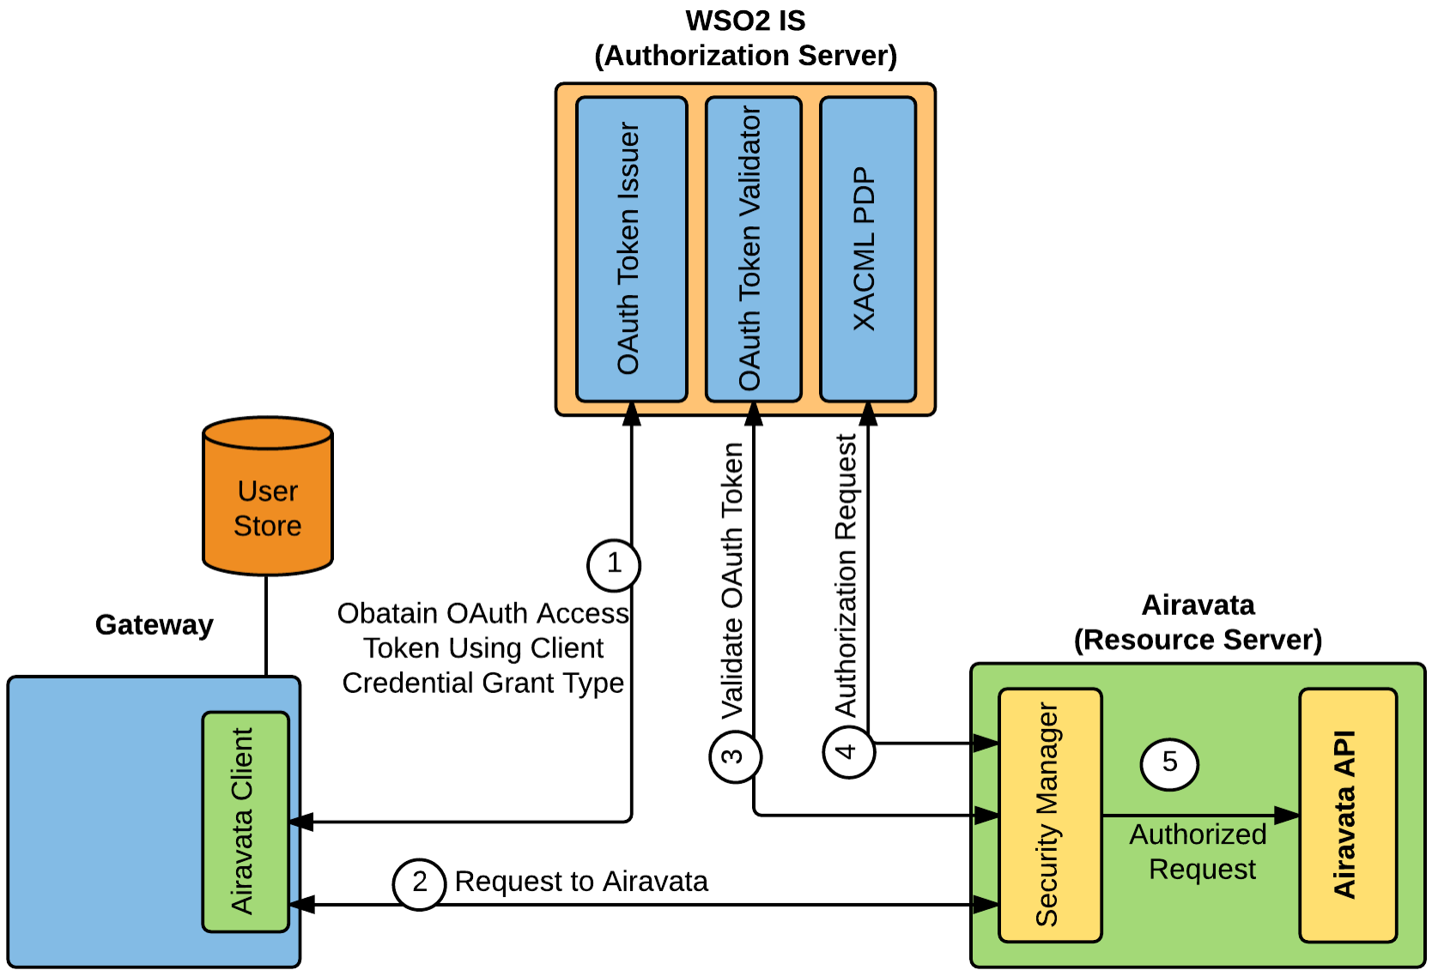
Case 3(a): Gateway maintains its own isolated User Store and does not share information with Airavata.
User authentication happens externally.
This requires a Client Credential grant type between the gateway and Airavata.

Slide 74
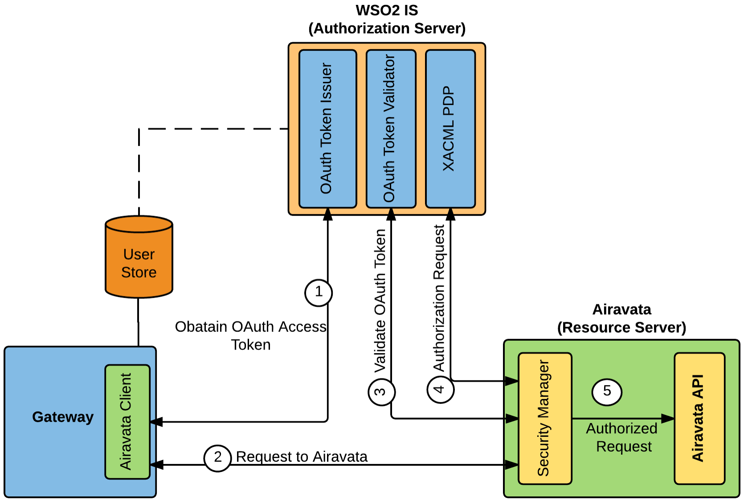
Case 3(b): Gateway shares read access to its User Store with Airavata.
The gateway uses OIDC to authenticate to the authorization server
This uses the Authorization Code grant type.

Slide 75
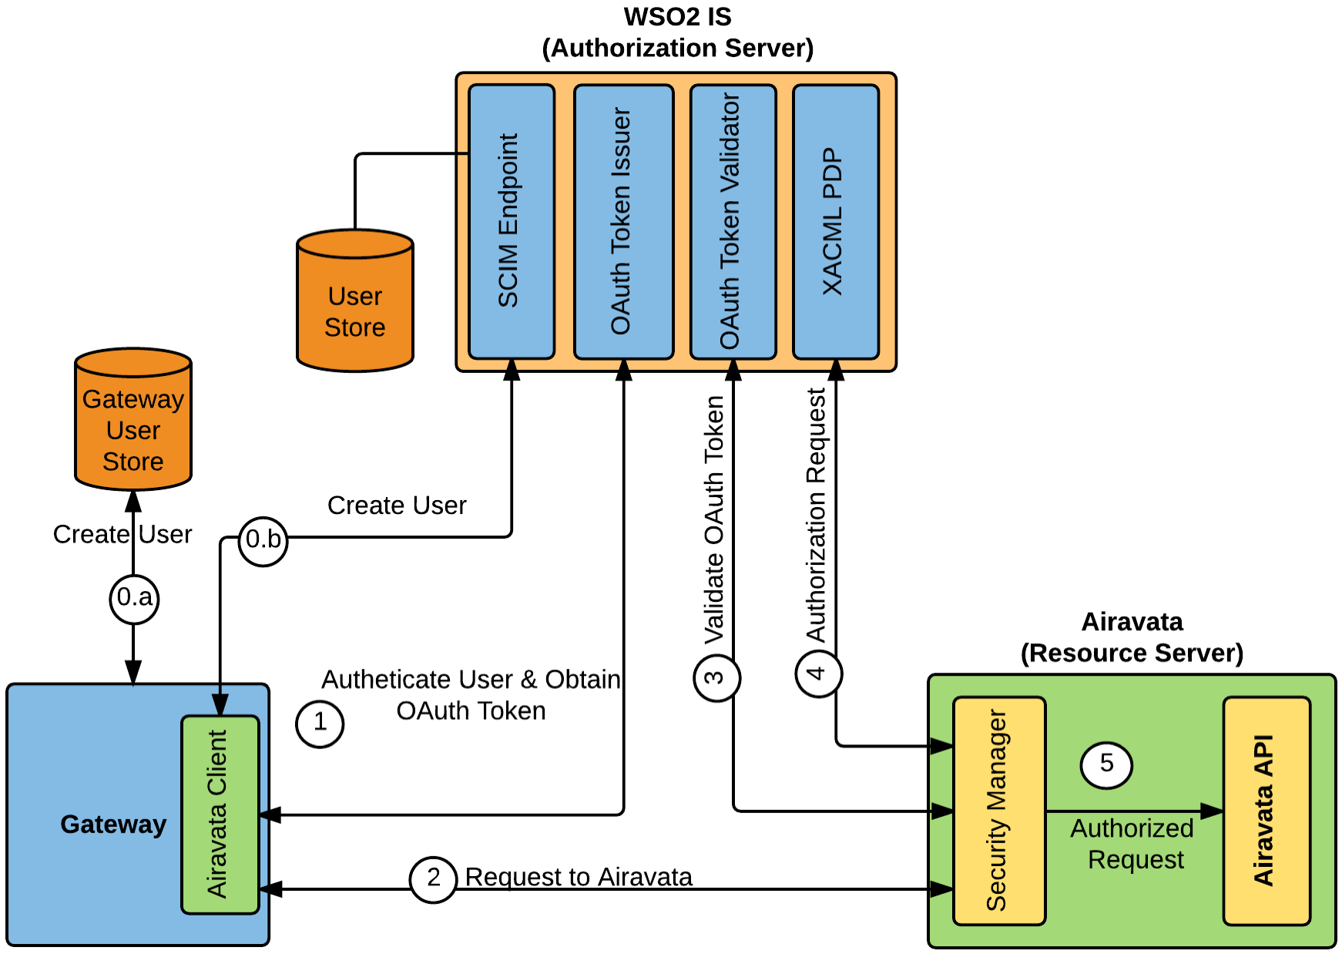
Case 3(c): Gateway duplicates its user store for Airavata.
The gateway uses Airavata’s Authorization Server to provide OIDC-based authentication.
This uses the Authorization Code grant type.
SCIM is the protocol for duplicating user information across multiple user stores.

